Slide 1

Unit 8

Slide 2
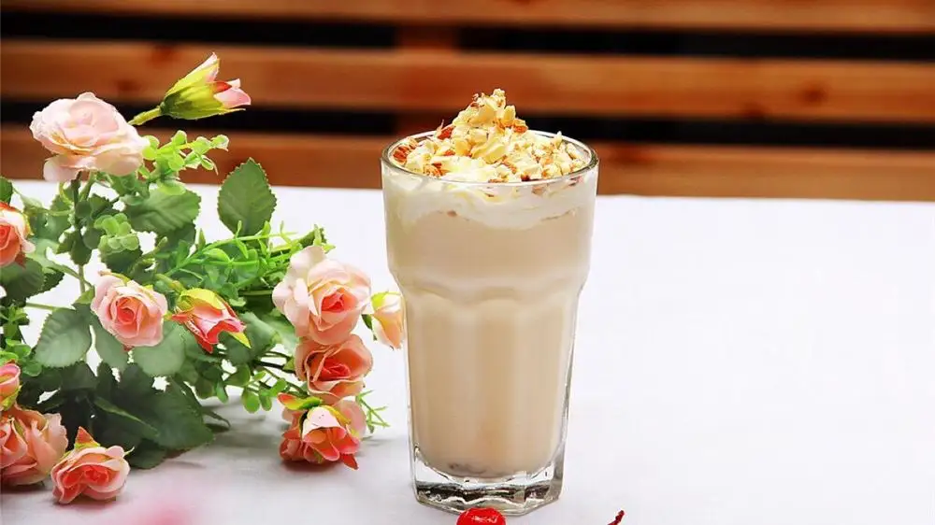
Unit 8
How do you make a banana milk shake?

Slide 3
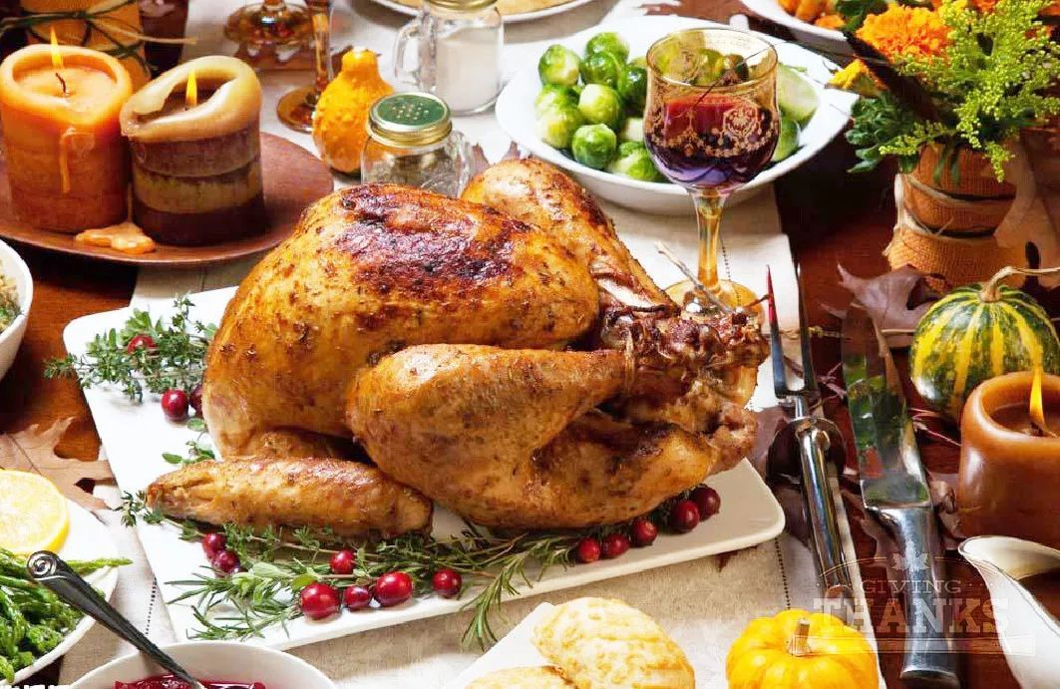


Slide 4


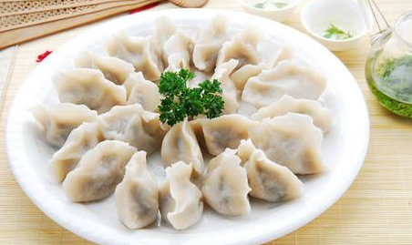
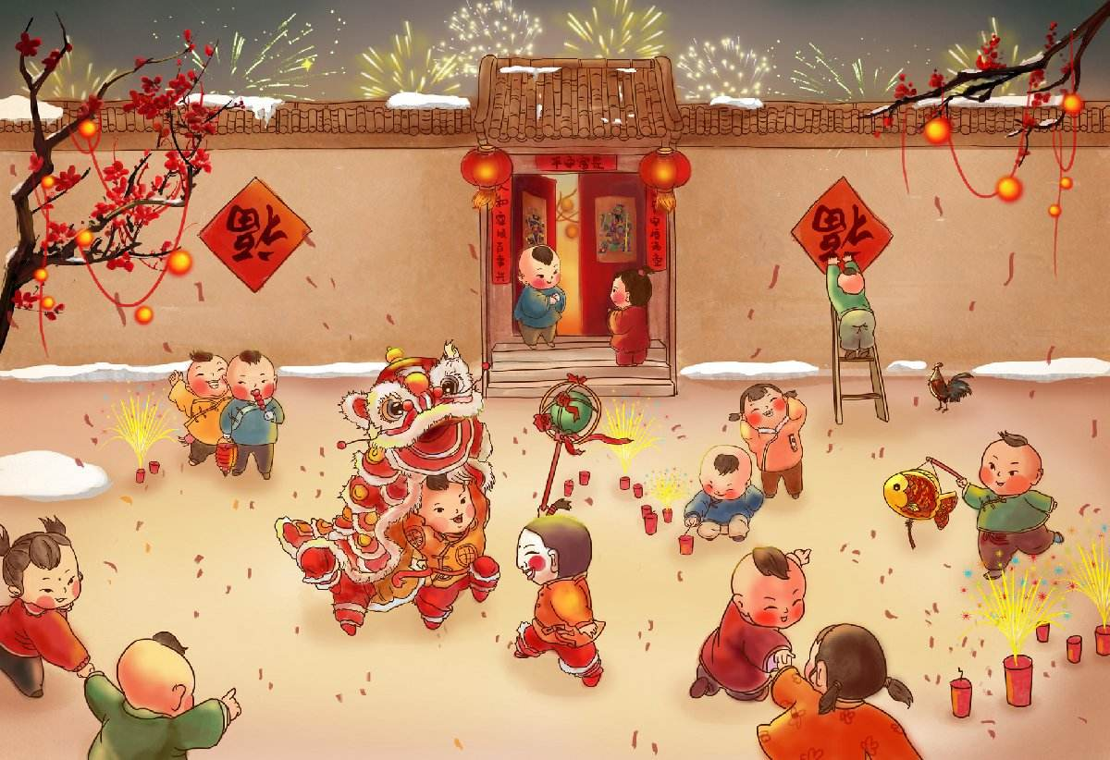
Let’s think and say!
What kind of traditional food do people eat on special holidays in China?
adj. 传统的; 惯例的
We eat ... to celebrate ....Festival.
v. 庆祝
dumplings
Spring Festival

Slide 5
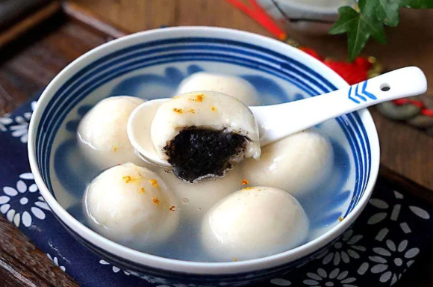
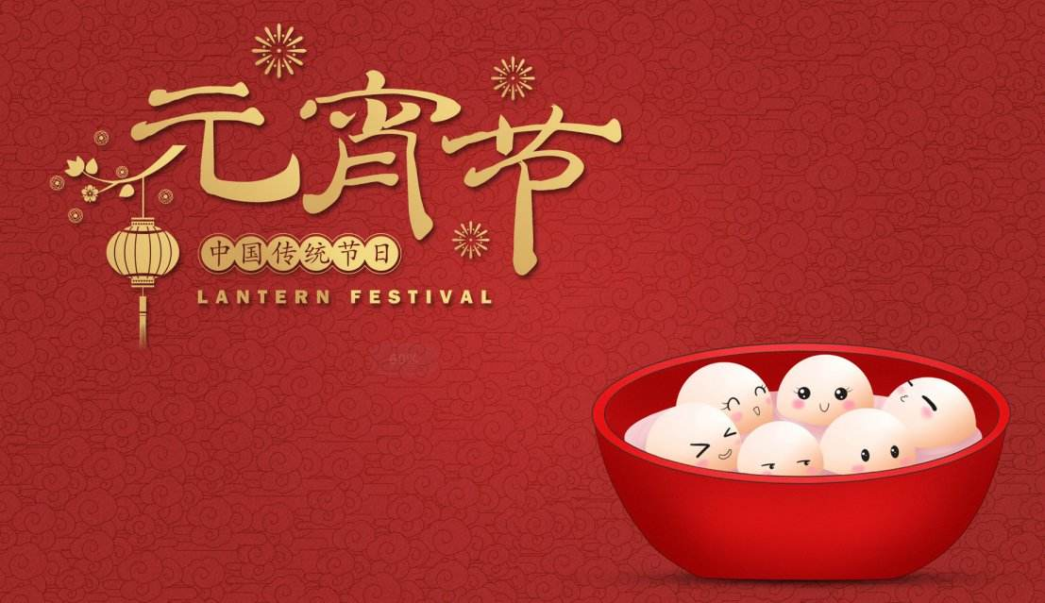
Let’s think and say!
What kind of traditional food do people eat on special holidays in China?
We eat ... to celebrate ....Festival.
Lantern Festival
sweet dumplings

Slide 6
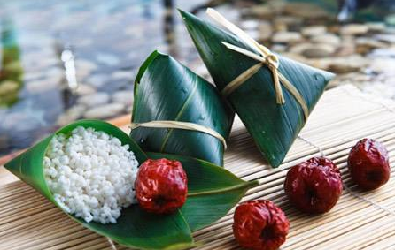
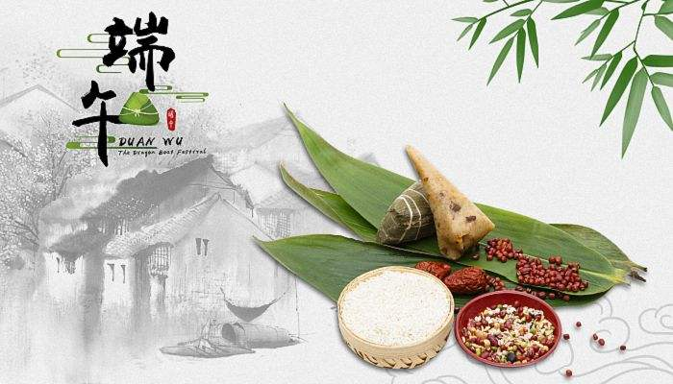
Let’s think and say!
What kind of traditional food do people eat on special holidays in China?
We eat ... to celebrate ....Festival.
zongzi
Dragon Boat Festival

Slide 7
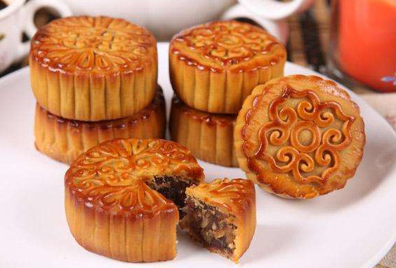
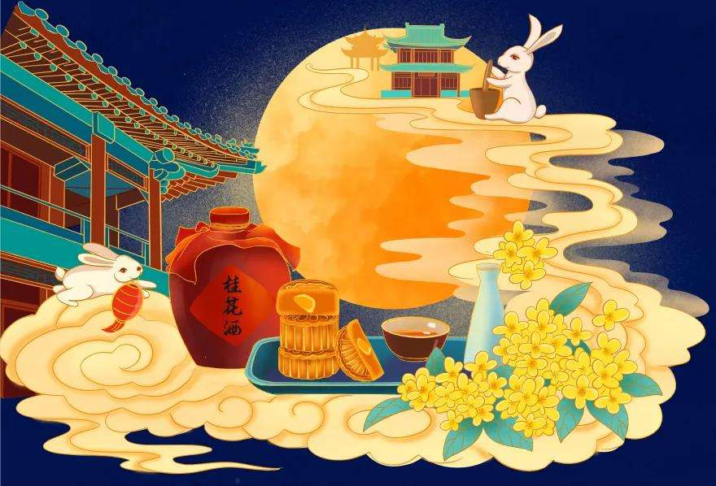
Let’s think and say!
What kind of traditional food do people eat on special holidays in China?
We eat ... to celebrate ....Festival.
mooncakes
Mid-Autumn Festival
In most countries, people usually eat traditional food on special holidays. Let’s learn a passage about Thanksgiving.
n. 感恩节

Slide 8


Thanksgiving in North America

Slide 9

Read the first part of the article carefully and answer the following questions.
1. Where do people celebrate Thanksgiving?
2. When do people celebrate it?
3. Why is Thanksgiving important?
4. How do people celebrate it?
5. What is the main dish of the Thanksgiving meal?

Slide 10

Read the first part of the article and answer the following questions.
1. Where do people celebrate Thanksgiving?
2. When do people celebrate it(Thanksgiving)?
3. Why is Thanksgiving important?
People celebrate Thanksgiving in North America.
In the United States, it is always on the fourth Thursday in November and in Canada, it falls on the second Monday in October.
Because it is a time to give thanks for food in autumn and other good things people enjoy in life.

Slide 11
4. How do people celebrate it?
5. What is the main dish of the Thanksgiving meal?
感恩节大餐的主菜是什么？
Families get together and usually celebrate it with a big family meal.
The main dish of this meal is almost always turkey.

Slide 12
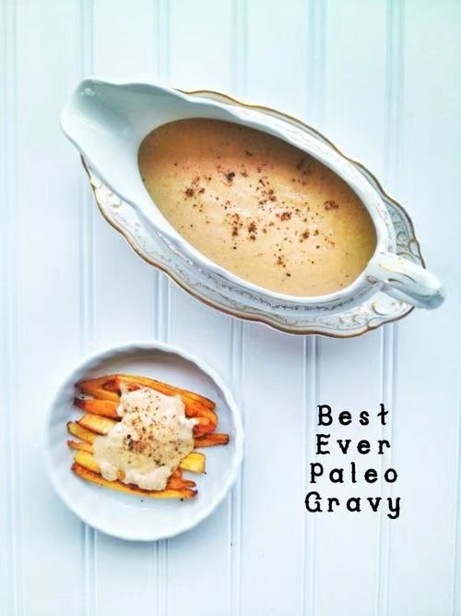
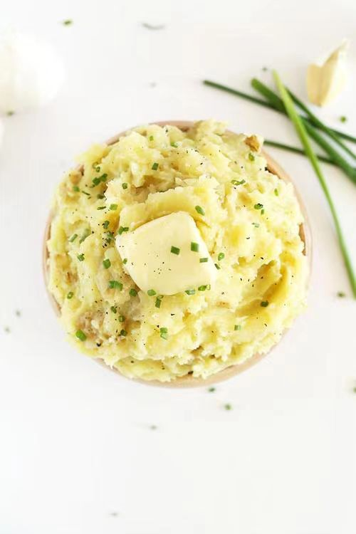
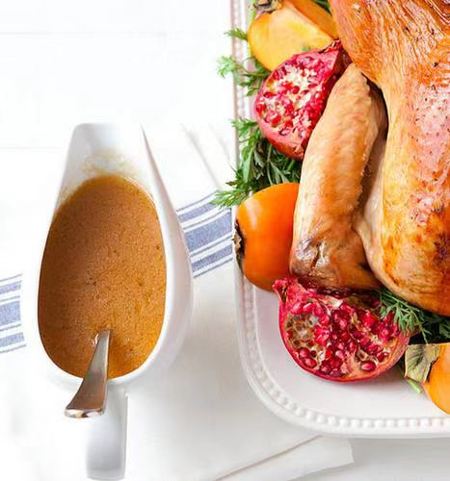
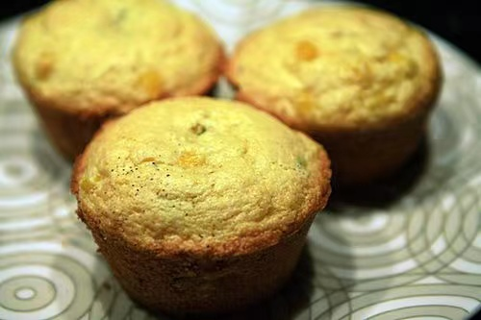
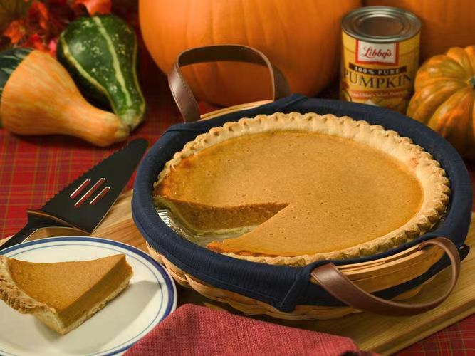
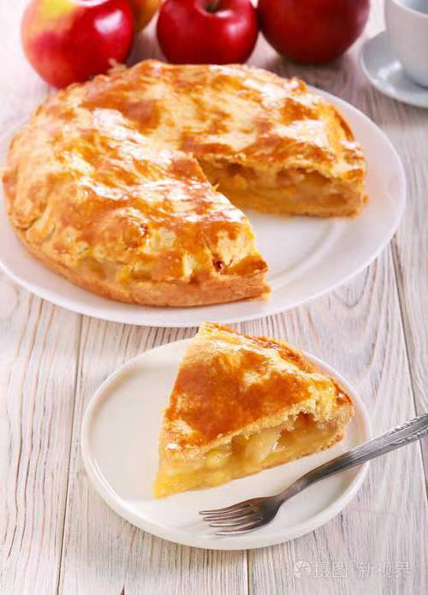
Thanksgiving Meal
gravy
cornbread
mashed potatoes
pumpkin pie
apple pie

Slide 13
Let’s read!
Thanksgiving in North America
In most countries, people usually eat traditional food on special holidays. A special day in North America is Thanksgiving. In the United States, this festival is always on the fouth Thursday in November, but in Canada it falls on the second Monday in October. Thanksgiving is a time to give thanks for food in the autumn and other good things people enjoy in life. Families see Thanksgiving as a time to get together and usually celebrate it with a big family meal. The main dish of this meal is almost always turkey, a large bird. To go with the turkey, people often prepare other things, such as gravy, cornbread, mashed potatoes, and pumpkin or apple pie.

Slide 14
Thanksgiving in North America
Topic:In most countries, people usually eat traditional food on special holidays. A special day in North America【Where】 is Thanksgiving. When:In the United States, this festival is always on the fouth Thursday in November, but in Canada it falls on the second Monday in October. Why:Thanksgiving is a time to give thanks for food in the autumn and other good things 【people enjoy in life. 】How:Families see Thanksgiving as a time to get together and usually celebrate it with a big family meal.What: The main dish of this meal is almost always turkey, a large bird. To go with the turkey, people often prepare other things, such as gravy, cornbread, mashed potatoes, and pumpkin or apple pie.

Slide 15

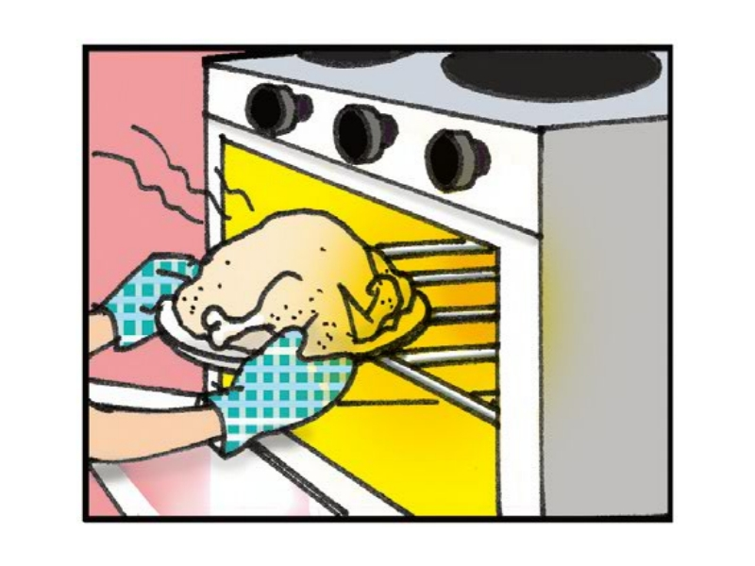
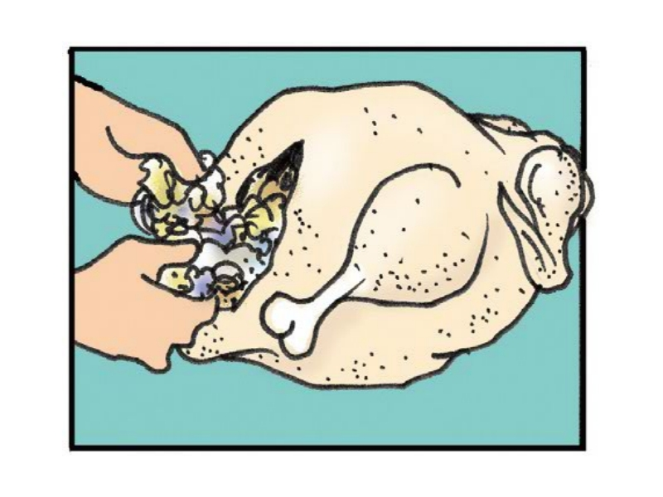
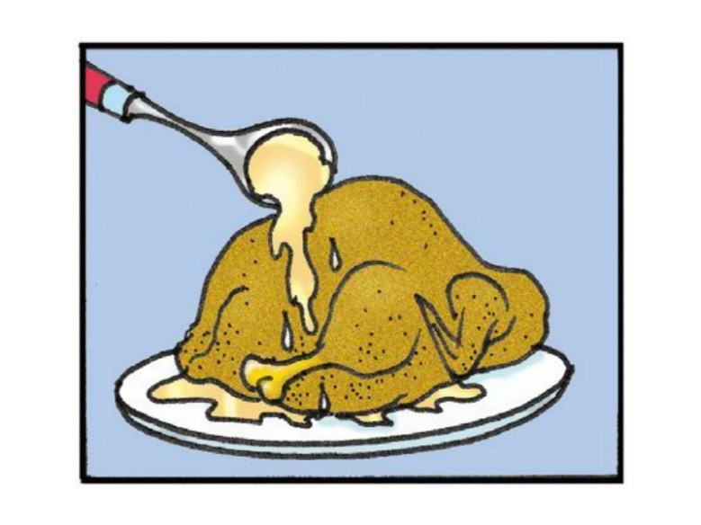
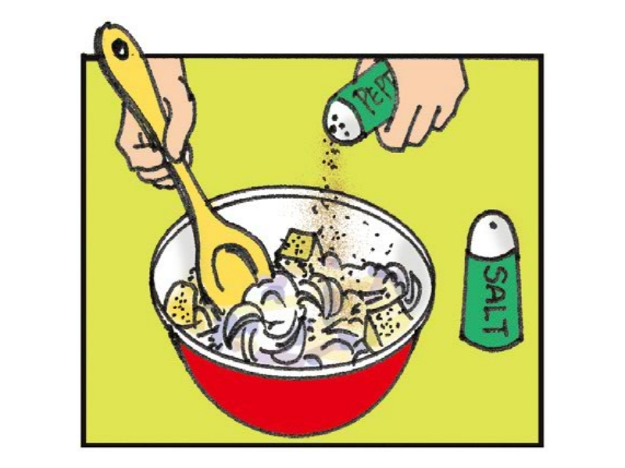
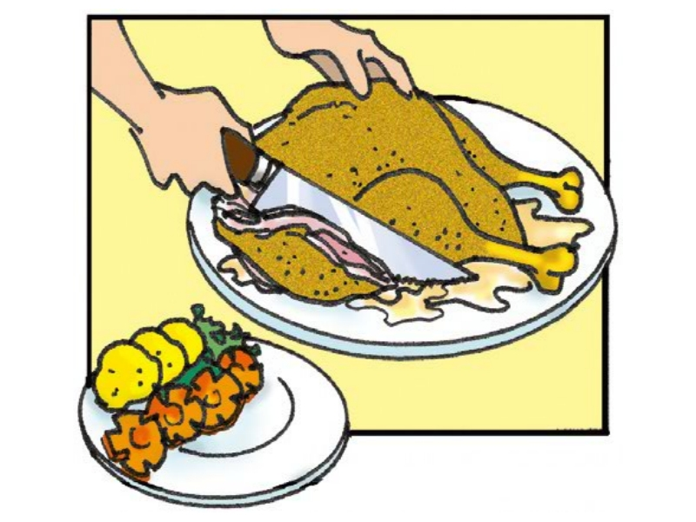
Read the next part of the article and number the pictures [1-5].
3
2
4
1
5

Slide 16
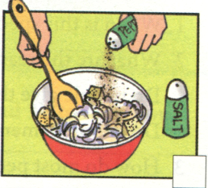
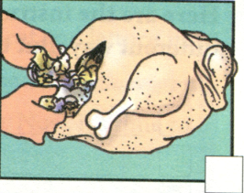
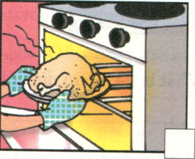
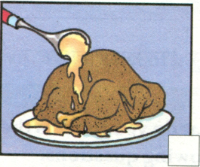
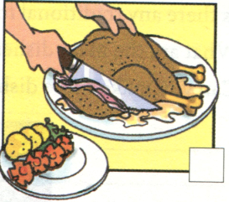
Let’s read!
Making a turkey dinner
Here is one way to make turkey for a Thanksgiving dinner.
First, mix together some bread pieces, onions, salt and pepper.
Next, fill the turkey with this bread mix.
Then, put the turkey in a hot oven and cook it for a few hours.
When it is ready, place the turkey on a large plate and cover it with gravy.
Finally, cut the turkey into thin pieces and eat the meat with vegetables like carrots and potatoes.

Slide 17





Here are the instructions(用法说明) for making a turkey dinner written in a different way. Put them in order. Write First, Next, Then and Finally.
_______, serve it to your friends with some vegetables.
_______, put this into the bird.
_______, cook it at a very high temperature for a long time.
_______, put everything you need together in a large bowl.
Finally
Next
Then
First

Slide 18
Try to find the same expressions in the passage.
Put everything you need together in a large bowl.
Put this into the bird.
Cook it at a very high temperature for a long time.
Serve it to your friends with some vegetables.
Mix together some bread pieces, onions, salt and pepper.
Fill the turkey with this bread mix.
Put the turkey in a hot oven and cook it for a few hours.
Cut the turkey into pieces and eat with vegetables like carrots and potatoes.

Slide 19



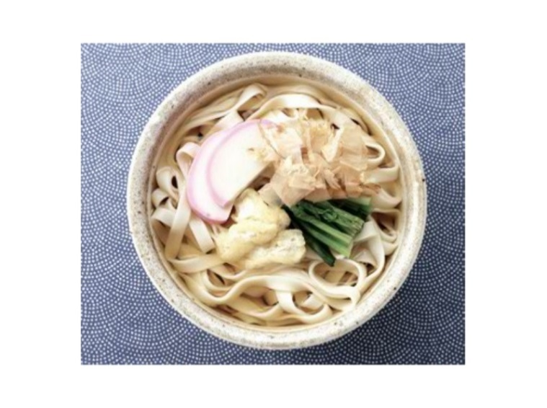
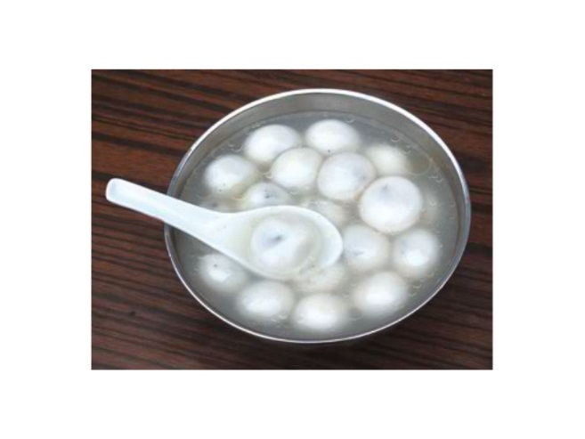
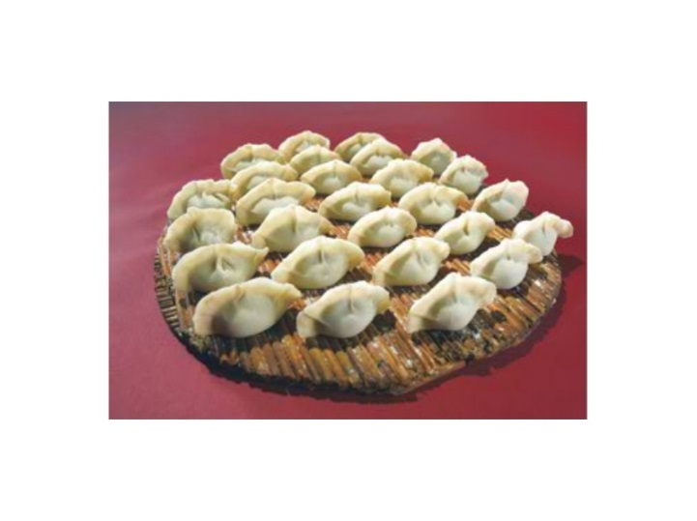
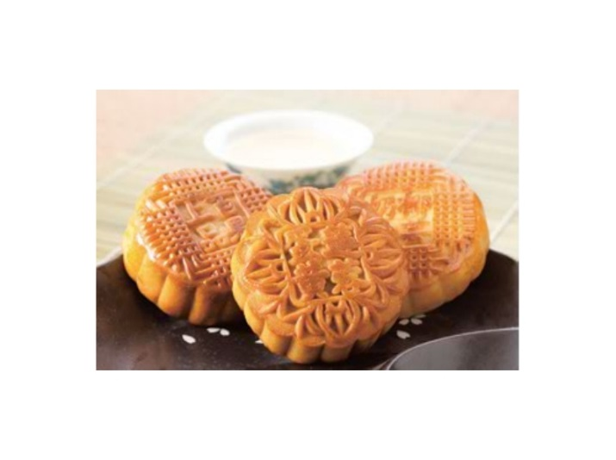
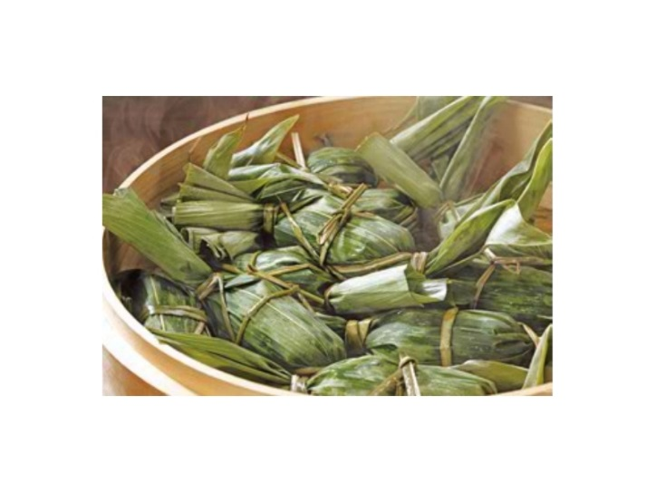
What (do you think) is the most special day in China? Answer the following questions.
1. When is this special day?
2. What are the reasons for this special day?
Do people give thanks for anything on this day?
Do people remember anything or anyone on this day?
3. How do most people celebrate this day?
4. Is there any traditional food? What are the main dishes?
5. Can you make these dishes?

Slide 20
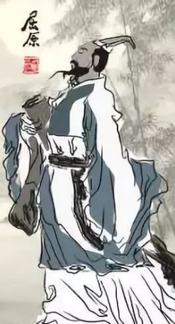
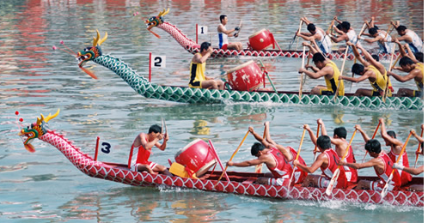
Let’s take Dragon Boat Festival as an example.
When?
Why?
How to celebrate?
What is the main dish?
on the 5th day of the fifth lunar(阴历的) month
remember the famous poet Qu Yuan
eat zongzi; hold dragon boat races;
drink realgar wine(雄黄酒);
hang mugwort (艾叶); wear a spice bag (香囊)
zongzi

Slide 21
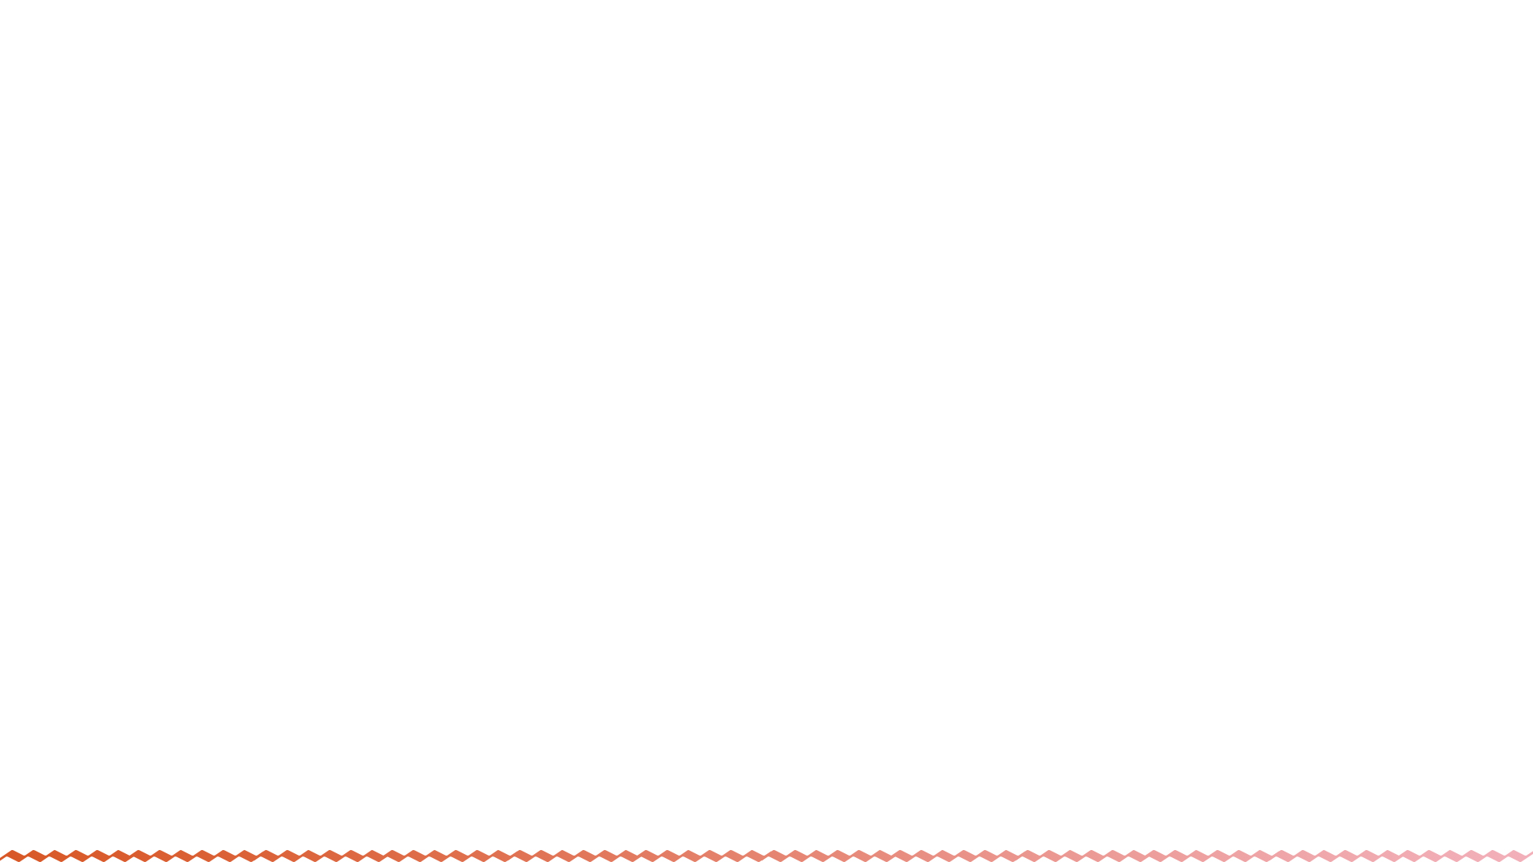

传统食物
在特别的节日
因……表示感谢/感恩
把……和……混在一起
用……装满……
用……覆盖……
将……切成片
用某物招待某人
在高温下
traditional food
on special holidays
give thanks for ...
mix (together)... and/with ...
fill ... with ...
cover ... with ...
cut ... into pieces
serve sth to sb.
at a very high temperature

Slide 23
Let’s read!
Making a turkey dinner
Here is one way to make turkey for a Thanksgiving dinner.
First, mix together some bread pieces, onions, salt and pepper.
Next, fill the turkey with this bread mix.
Then, put the turkey in a hot oven and cook it for a few hours.
When it is ready, place the turkey on a large plate and cover it with gravy.
Finally, cut the turkey into thin pieces and eat the meat with vegetables like carrots and potatoes.

Slide 24
Try to find the same expressions in the passage.
Serve it to your friends with some vegetables.
Put this into the bird.
Cook it at a very high temperature for a long time.
Put everything you need together in a large bowl.
Cut the turkey into pieces and eat with vegetables like carrots and potatoes.
Fill the turkey with this bread mix.
Put the turkey in a hot oven and cook it for a few hours.
Mix together some bread pieces, onions, salt and pepper.

Slide 25



To read to learn Thanksgiving and its special food
To read to learn the process of making turkey
To learn the new words and expressions

Slide 26


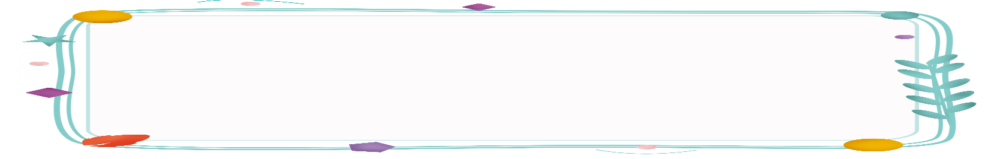
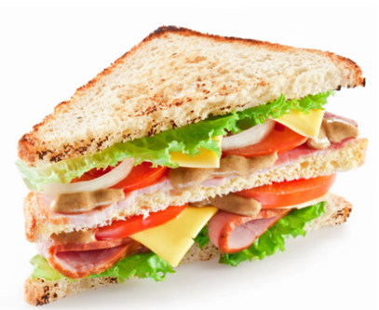
How to make a sandwich?
First,
Next,
Next,
Next,
Then,
Finally,
put the butter on a piece of bread.
cut up one tomato. Put the tomato on the sandwich.
cut up an onion.
put some cheese on the sandwich.
put some lettuce on the cheese.
put another piece of bread on top.

Slide 27

What days are special to us Chinese?
Can you name some?
Mid-Autumn Festival
Spring Festival
Lantern Festival
Dragon Boat Festival
Why are these days special to us?

Slide 28
adj. 传统的; 惯例的
What kind of traditional food do people eat on special holidays in China?
sweet
dumplings
zongzi
mooncakes
dumplings
Different countries have different traditional holidays and eat different foods. Let’s learn something about Thanksgiving.
n. 感恩节

Slide 29

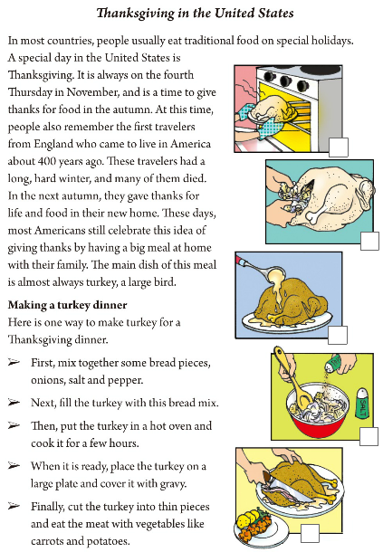

Look at the pictures on page 61 and answer the questions.
1. What kind of food are they making?
2. On which special day do people in North America eat it?
Turkey.
Thanksgiving Day.

Slide 30

Read the first paragraph quickly and answer the question.
When is Thanksgiving Day in the United States and Canada every year?
In the United States, this festival is always on the fourth Thursday in November, but in Canada it falls on the second Monday in October.

Slide 31
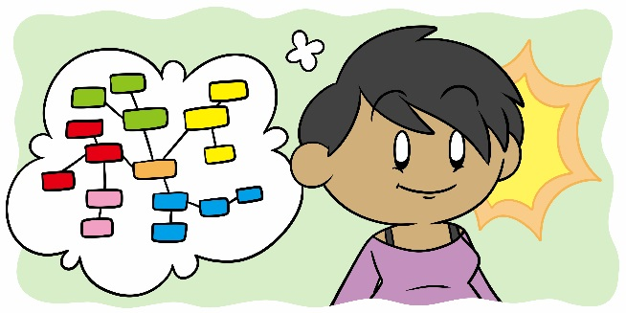
Complete the blanks.
Why? _____________________________________
___________________________________________
A time to give thanks for food in the autumn and other good things people enjoy in life.
When? _____________________________________
___________________________________________
A ______ day
In the United States, the fourth Thursday in November. In Canada, the second Monday in October.
special
______________________________________________
_______________________
How to celebrate?
Families get together and celebrate it with a big family meal.
Thanksgiving Day
What is the main dish?_________
Turkey.
How to make it?

Slide 32

First, ____________________________
_________________________
Next,_____________________________
Then, ____________________________
_______________________
After that, ________________________
_______________________
Finally, __________________________
_______________________
mix with bread pieces, onions, salt and pepper.
fill the turkey with the bread mix.
A special day
How to make it?
put the turkey in a hot oven and cook for a few hours.
place it on a plate and cover it with gravy.
Thanksgiving Day
cut it into pieces and eat with vegetables.

Slide 33

the Dragon Boat Festival

Slide 34

Ⅰ. 根据句意，从方框中选择恰当的单词填空, 注意形式变化。
traditional, pepper, serve, celebrate, mix, temperature, piece, prepare, autumn, plate
1. The turkey is ready. Please _______ it to your friends.
2. I think the Spring Festival is the most important ___________ festival in China.
3. I had three _______ of bread for breakfast this morning.
4. The leaves (叶子) begin to fall when ________ comes.
5. It’s my mother’s birthday tomorrow. We will go out for a meal to ___________.
serve
traditional
pieces
autumn
celebrate

Slide 35
traditional, pepper, serve, celebrate, mix, temperature, piece, prepare, autumn, plate
6. Look! The students are busy _________ for the English test.
7. _______ red and yellow, and you will get orange.
8. He put some _______ in the soup. He thought it was delicious.
9. Don’t leave the dirty bowls and _______ in the sink (洗碗槽). Wash them now.
10. When you bake fish, the key is to bake it at a high ____________ for a short time.
preparing
Mix
pepper
plates
temperature

Slide 36
Ⅱ. 根据汉语意思，完成英语句子，每空一词（含缩略形式）。
1. 那个魔术师把杯子里装满了水。
That magician _______ _______ _______ _______ _______.
2. 我们应该感恩我们很健康。
We should _______ _______ _______ our good health.
3. Mary笑了，用一只手捂着她的嘴。
Mary laughed and _______ _______ _______ _______ _______ _______.
4. 把东西收拾好，该上床睡觉了。
Put your things away. _______ _______ _______ go to bed.
filled the cup with water
give thanks for
covered her mouth with her
hand
It’s time to

Slide 37
5. 她把她的玩具狗看作最好的朋友。
She _______ her toy dog _______ her best friend.
sees as
6. 这儿有一种可以帮助你省钱的办法。
_______ _______ _______ _______ _______ help you save money.
7. 我喜欢和我姐姐在特别的节日里交换礼物。
I like to exchange gifts with my sister _______ _______ _________________.
Here is a/one way to
on special
holidays / festivals

Slide 38
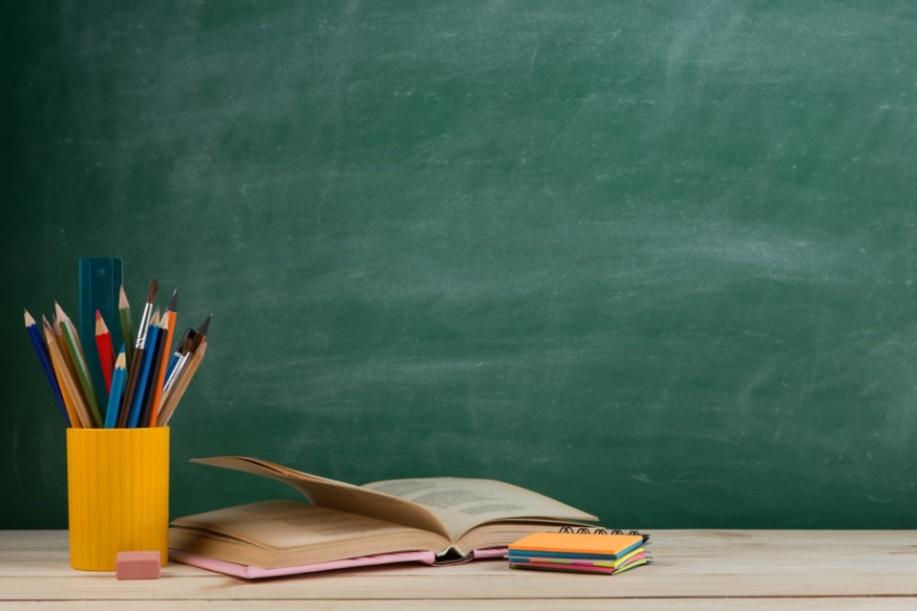

1. Write a summary of the article.
2. Preview 3a-4 on P63-64.

Slide 39


